Slide 1
“13th Humor Research Conference”
Organized by
Applied Linguistics Lab at Texas A&M University-Commerce
The Humor Didactical Approach to Enhance the Reading Comprehension Skill
NESBA Asma (University of El Oued, Algeria )

Slide 2
The Outline
Introduction & Aim of the study
Research Questions
Methodology
Results and Discussion
Conclusion
Recommendations

Slide 3
Introduction and Aim of the Study
Teaching languages to young age groups has always relied on entertaining methods. This proved to have a positive impact on the learning process. For this reason, learning through games, songs, jokes, funny stories, comics . . . etc . was adopted by EFL teachers. Therefore, humor was incorporated while presenting the reading comprehension skill by Algerian teachers.
The current study aims at evaluating the utility of incorporating humor in reading comprehension assignments devoted to EFL contexts to teach young learners.

Slide 4
RESEARCH QUESTIONS
The study aims at answering the following questions:
What are the teachers’ attitudes towards utilizing humor in reading comprehension texts and assignements?
01
How is humor incorporated in the reading comprehension texts?
02

Slide 5
Methodology
A study was conducted during the academic year 2022/2023 in which six middle school teachers of English were interviewed to inquire about the possible outcomes resulted from the adoption of humor in the selected reading texts assigned to middle school pupils.

Slide 6
RESULTS AND DISCUSSION
The participants agreed that humor in the reading passages is maintained through two devices:
Words
Linguistic Device
Phrases
01
Idioms
Irony
Typographical Device
A caricature aiming at creating a comic or grotesque effect.
02

Slide 7
RESULTS AND DISCUSSION
As far as the teachers are concerned, results reveal that they:
01
Have a positive attitude towards the humor-based texts
Consider humor as an efficient didactical approach to motivate the pupils to learn foreign languages
02

Slide 8
RESULTS AND DISCUSSION
Concerning the impact of humor on pupils, teachers noticed
A considerable engagement and involvement of the pupils with the different activities related to the reading comprehension texts that contain humor
01
The pupils responded to the tasks in a more rapid way with an increasing attention and mass participation to answer the questions
02

Slide 9
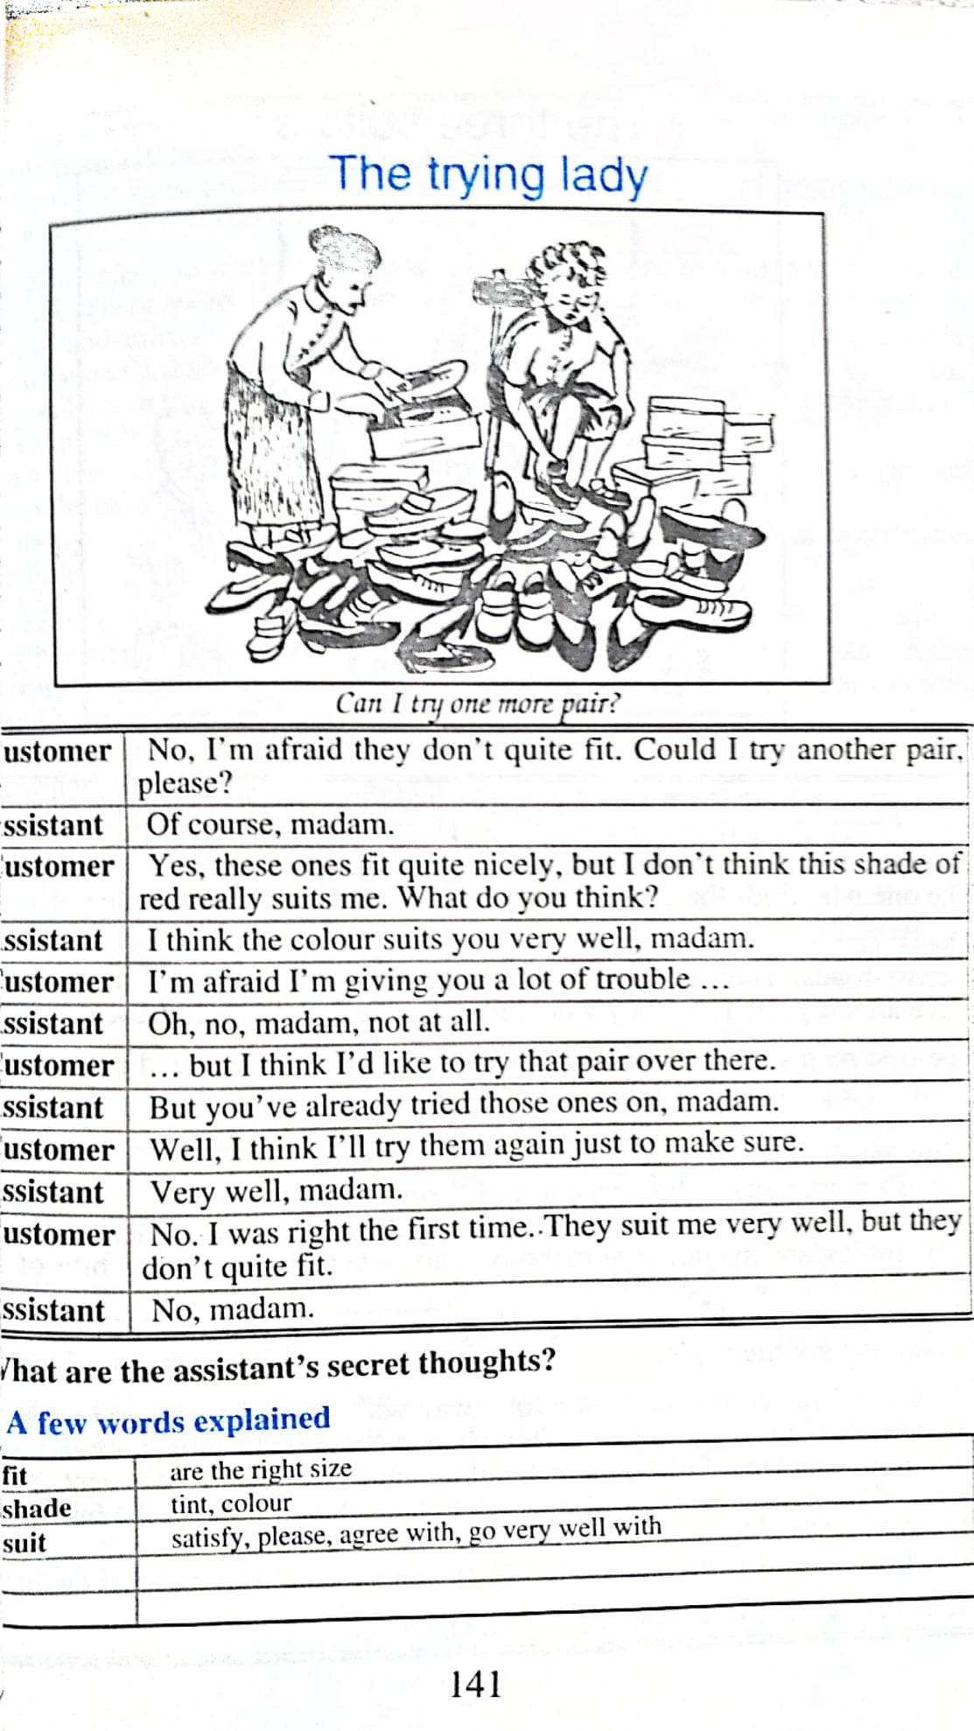
The caricature can occupy the totality of the reading passage accompanied with summarizing captions. It can also be incorporated in a long text as a facilitating visual material reinforcing the message conveyed by the reading text.

Slide 10
CONCLUSION
1- Humor occupies a large scope in EFL teaching and learning contexts.
2- Humour facilitates the comprehension of the reading passages.
3-Caricatures incorporated in texts contribute in providing a preliminary general idea of the reading passage. Therefore, they can be a good technique to ensure the skimming of the text .

Slide 11
IMPLICATIONS AND RECOMMENDATIONS
Recommendations were provided to teachers to exploit the children's tendencies to humor to further include it in acquiring other language skills such as speaking and writing.

Slide 12
References
Bremmer, Jan & Roodenbury, Herman (Eds.), (1997). A Cultural History of Humour. Blackwell Publishers Inc., Malden, Mass.
Chall, J. S. (1983). Stages of Reading Development: New York: McGraw-Hill.
Hutchinson, K. (1949). An experiment in the use of comics as instructional material. Journal of Educational Sociology, 23: 236-245.
Klingner, Janette K., Vaughn, Sharon. & Boardman, Alison. 2007. Teaching Reading Comprehension to Students with Learning Difficulties. London: The Guilford Press.
Martin, Rod A. 2007. The Psychology of Humor: An Integrative Approach. Elsevier Inc. All
McVicker, C. J. (2007). Comic strips as a text structure for learning to read. The Reading Teacher, 61(1): 85–88.

