Slide 1
Playing with Power and Vulnerability in Autobiographical Works of Bill Cosby and Richard Pryor
Dr. Tuula Kolehmainen, Humor Research conference 2023

Slide 2
Power & vulnerability
Vulnerability: openness to being hurt emotionally or physically
power: the ability to control people, places, and situations
Appear on the macrolevel of societal norms, social structures, and institutions as well as the microlevel of everyday communication and individual men’s experiences
Vulnerability is stereotypically associated with women and power with men

Slide 3
What tension?
while Black men cannot achieve power or hegemonic masculinity because of their feminization, they are nevertheless categorized as hypermasculine in society and patriarchal in academic discourse .
other aspects of Black male vulnerability, such as “childhood trauma, sexual violence, loneliness, depression, indignity, and self-loathing” (2019, 1), are rarely mentioned in discussions of Black men.

Slide 4
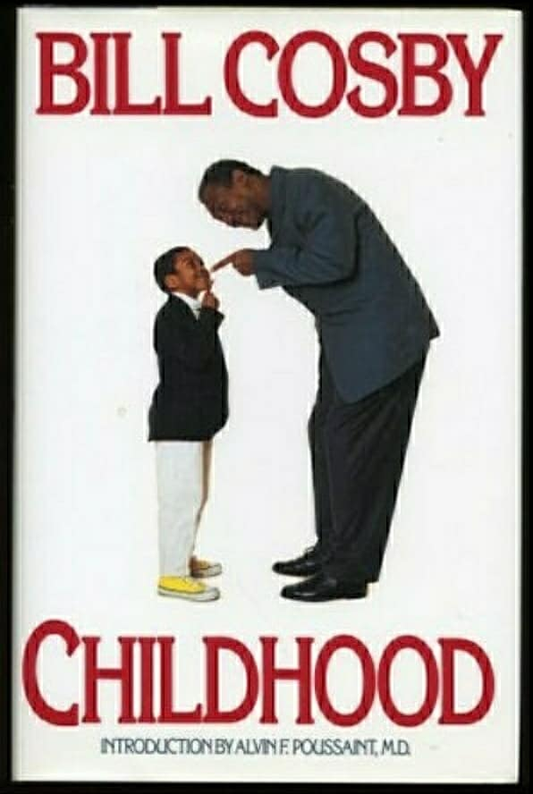
The Material

Slide 5
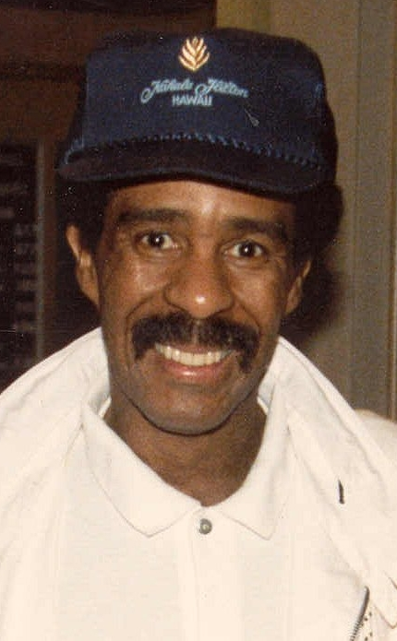
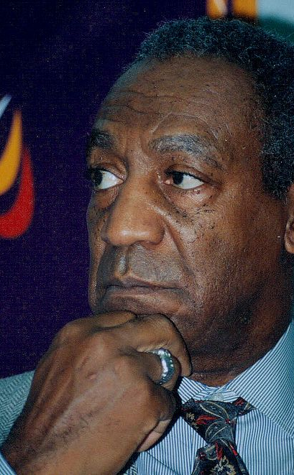
The Comedians
“Crazy Black Man” Richard pryor 1940–2005
“America’s Dad” Bill cosby 1937–

Slide 6
Bill Cosby: Childhood (1991)
a constant narrative of violence : jokes, threats
violence as a natural part of boyhood
Taking part in actual fights, however, leads to humiliation or more violence at home.
Lying becomes a survival strategy

Slide 7
“When I reached my house, my father was there and he welcomed me.
‘What the hell happened to you?’
‘Bernie beat me up,’ I said.
‘How come you let him do that?’
‘It wasn’t my idea. He did it on his own.’
‘Okay, now here’s what I want you to do: I want you to go right back and beat him up.’
‘He sure won’t be expecting that.’
‘Right. You’ll catch him by surprise.’
‘Yeah, he will be surprised I wanna get killed again.’
‘Look, I don’t want to be ashamed of you; I want you to be a man. If you don’t go back there and beat that guy up, I’m gonna beat you up.’
‘Why don’t you just beat him up? Then it comes out even.’” (109; emphasis original)

Slide 8
Richard pryor: Pryor convictions and Other Life Sentences (1995)
I saw shit that would cause an adult nightmares. Heard tales about hangings and murders that happened just because a man happened to be black. Strange shit” (28)
“raped, expelled, abused, and victimized by the sting of racism” (54) “growing up was a minefield” (40)
You didn’t trust anybody. You watched your back. You covered your ass. You said whatever you had to to stay out of trouble” (45)

Slide 9
Illusion of power
Cosby “Mrs. McKinney and a few of the kids laughed and the laughter hit me like a drug” (117)
Pryor “I was desperate to matter. . . . It eased my pain and insecurity, erased the fear, turned me into a whole new man” (68)

Slide 10
Thank you!
contact
bibliography
Tuula.kolehmainen@utu.fi
Twitter @Kolehmaistuula
Cosby, Bill. 1991. Childhood. New York: Bantam Books.
Curry, Tommy, J. 2017. The Man-Not: Race, Class, Genre, and the Dilemmas of Black Manhood. Philadelphia: Temple University Press.
Pryor, Richard. 2018. Pryor Convictions and Other Life Sentences: The Official Autobiography. Los Angeles: Rare Bird Books.
Watkins Mel. 1999. On the Real Side: A History of African American Comedy from Slavery to Chris Rock. Chicago: Lawrence Hill Books.

