Slide 1
What makes Russian words funny: the phenomenon of one-word humor
Arseny D. Anisimov (he / him / his)
student of “Fundamental and Computational Linguistics”
Higher School of Economics, Moscow

Slide 2
1. Previous studies based on English analyzed single non-words and single words [Westbury et al. 2016; Westbury & Hollis 2019].
Factors predicting humor judgement in English:
containing rude-alluding substrings
lower average entropy per letter (consisting of more rare letters)
lower word frequency
pertaining to 1 or more of the semantic groups ‘insult’, ‘sex’, ‘party’, ‘animal’, ‘non-sexual bodily functions’
non-words
words
The types of factors
semantics-related factors (taboo and/or positive emotions)
factors related only to the form
discourse-related (word frequency)

Slide 3
2. So, our aim was to
use experimental and statistical methods to find the factors of the meaning and form which make Russian words funny for Russian speakers.
Our samples
~900 answers to ”Write 3 words which you consider funny”
596 filtered words or short phrases (see 4)
40 the most frequent answers from 596 (see 3.1 and 3.2)

Slide 4
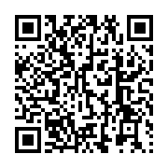
3. Experiments
3.1. Semantic differential. Are these 40 words actually funny?
Stimuli: 40 single words without variation in stress.
Fillers: 40 words from the same semantic categories.
Participants: 128 people, age from 12 to 62 (M=18.7, SD=8.64)
Methodic: 10 blocks on a page, 2 pages in the Google Forms. 1 block is a word-string or an audio recording and a table with 3 scales from 1 to 5. Participants answered to the questions ’How funny is this word?’, ’How understandable is this word?’, ’How often do you use this word?’.
There were 3 variants: with the word-strings, audio recording of male, and female voice.

Slide 5
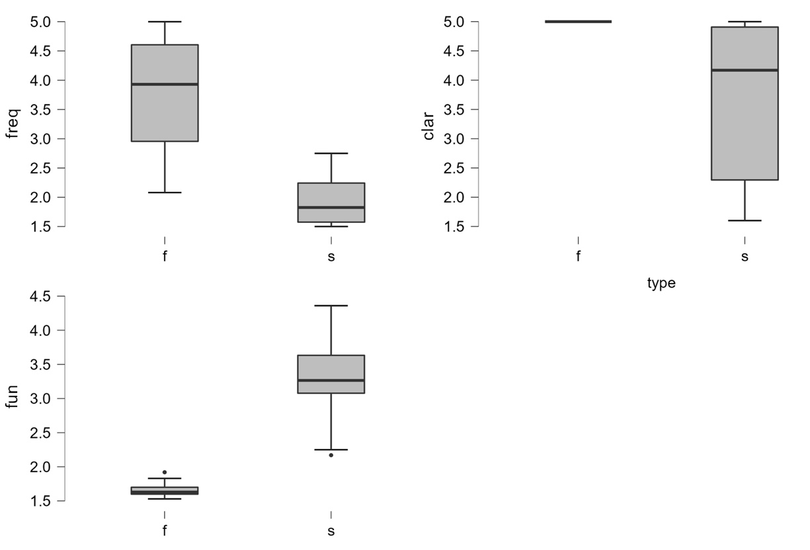
Clarity, subjective frequency and estimated funniness of stimuli and fillers.

Slide 6
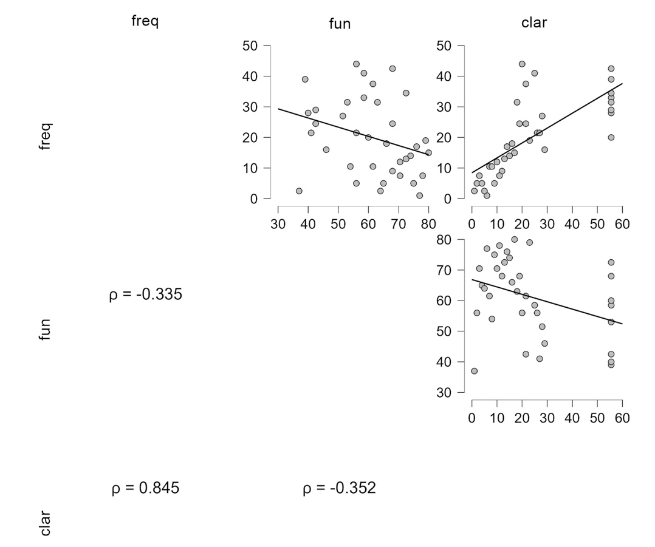
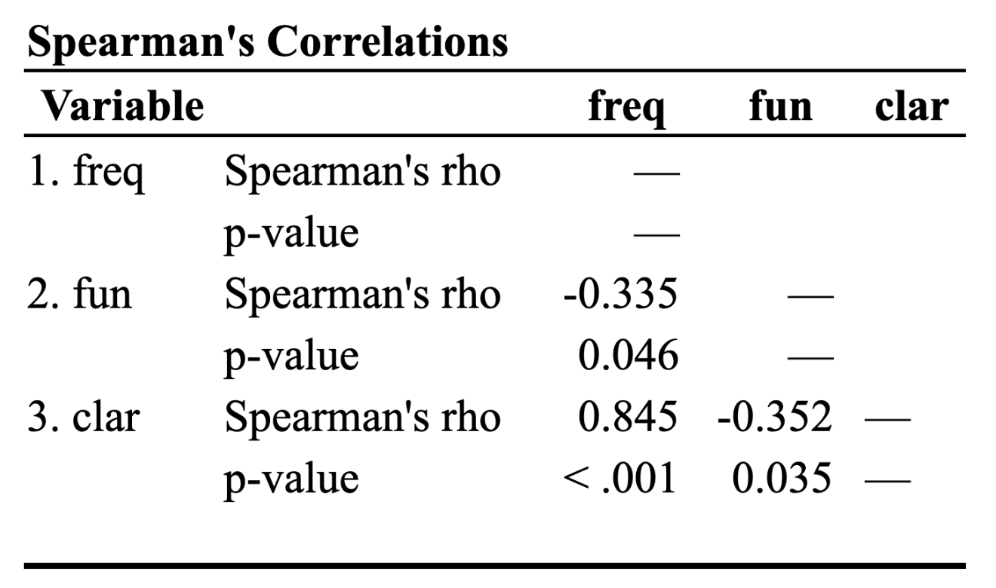

Slide 7
word | the funniest | the least funny
яга | 16 | 298
попытка | 60 | 291
скипидар | 51 | 247
боб | 67 | 286
лобзик | 61 | 239
канделябр | 61 | 213
калебас | 63 | 157
пельмень | 91 | 188
пупок | 86 | 172
анчутка | 75 | 147
многочлен | 94 | 183
пипетка | 86 | 155
черевички | 86 | 153
балясина | 74 | 131
сколопендра | 102 | 167
козявка | 86 | 132
курвиметр | 113 | 160
мамалыга | 97 | 131
курдюк | 106 | 127
смешнявка | 117 | 117
word | the funniest | the least funny
сопелька | 131 | 117
брандахлыст | 137 | 110
кулебяка | 132 | 103
жмых | 184 | 142
пюпитр | 130 | 98
выхухоль | 175 | 121
тютелька | 113 | 76
козлодёр | 151 | 89
пимпочка | 158 | 76
пипка | 183 | 74
пендельтюр | 199 | 77
потиральце | 207 | 75
пипидастр | 211 | 73
кандибобер | 216 | 73
мимозыря | 226 | 61
кракозябра | 213 | 54
барабулька | 213 | 52
хухря | 258 | 59
пердимонокль | 254 | 56
шмакодявка | 246 | 49
3.2. Best-Worst. Which of 40 are the funniest?
Stimuli: 40 single words.
Participants: 508 people, age from 12 to 62 (M=22, SD=10.7).
Methodic: 1 block on a page, 10 pages in the Google Forms. 1 block is 4 lists of 4 words with check-boxes. Participants had to choose one word in each category: the funniest, the least funny, the most understandable, the least understandable.
40 variants were made in order to make every word appear in different contexts.

Slide 8
 | distance | best-worst | sem. dif.
1 | 5 | яга | анчутка
2 | 7 | попытка | боб
3 | 2 | скипидар | канделябр
4 | 2 | боб | лобзик
5 | 1 | лобзик | скипидар
6 | 3 | канделябр | яга
7 | 8 | калебас | многочлен
8 | 4 | пельмень | черевички
9 | 20 | пупок | попытка
10 | 9 | анчутка | пипетка
… | … | … | …
30 | 7 | пипка | пердимонокль
31 | 7 | пендельтюр | хухря
32 | 6 | потиральце | козлодер
33 | 6 | пипидастр | сопелька
34 | 0 | кандибобер | кандибобер
35 | 0 | мимозыря | мимозыря
36 | 9 | кракозябра | пюпитр
37 | 11 | барабулька | брандахлыст
38 | 7 | хухря | потиральце
39 | 9 | пердимонокль | шмакодявка
40 | 1 | шмакодявка | пипидастр
average dist. | 6.2
the least funny
3.2. Best-Worst vs Semantic differential
Average distance in the pair is 6.2. If we suppose that the ratings in two experiments are not correlated, the expected average distance is 20. We are not sure what statistic metric should be applied to verify significance.
the funniest

Slide 9
4. Statistical differences between 596 funny words and the sample of the regular words
596 words or short phrases were compared with 25,000 lexemes from the ”Frequency dictionary of the modern Russian language” [Lyashevskaya & Sharov 2009].
4.1. Semantic groups
248 of 596 word (41%) belong to at least one of the groups:
ridiculuous or dismissive (казус)
food and related (кастрюля, тефтели)
animals and related (зяблик, пигидий)
sex (семяизвергание, теребонькать)
words with rude-alluding substrings (перкосрак, пердимонокль, просрачивают)
body parts and nonsexual bodily functions (сопелька)
cute (бирюлька, карапуз)
entertainment (батут, симпл-димпл)
distorted or obsolete (кепчук, убивец)
related to laughing (ржомба, смехотворение)
4.2. Diminutive suffixes
136 of 596 word (22.8%) have diminutive suffix or pseudosuffix (-онок, -ушк-/-юшк-, -очк-, -чик-, -ик-, -к-, -ок-). In the Frequency dictionary less than 10% of words contained a diminutive suffix.
It was called a pseudosuffix if the word did not exist without this element (барабулька).

Slide 10
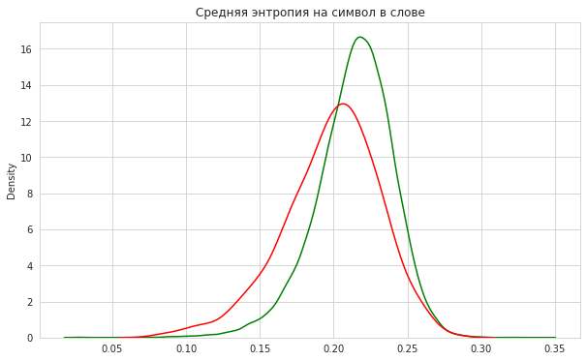
4.3. Lower letter entropy
The expectancy violation theory [Westbury et al 2015: 142-144] explains why words that sound "weird" can make a humorous effect. A native speaker has an idea of the statistical distribution of letters and sounds of his native language. Violation of this representation — for example, a large proportion of rare letters in a word — affects the evaluation of the word as more strange, peculiar. We found out that 596 funny words had lower average entropy per letter.
4.4. CVCV patterns
Repetitions of letters of the pattern CVCV and less often VCVC. Repetitions occur in 35 out of 593 words (5.9%), in ordinary words only in 448 out of 52139 (0.86%).
According to the chi-square criterion, this result is statistically significant.
In 28 of the 35 funny words, the repetition is at the beginning.
general words
funny words
Average letter frequency. t-test: statistic = 16.1307, p-value < 0.0001

Slide 11
5. Discussion
The main conclusion based on the results of the work is that predicting the humorous effect of even single words requires taking into account a large number of variables. The most effective predictors — clarity and subjective frequency — are formulated vaguely and are difficult to assess without interviewing a representative sample of speakers. Formal and clearer criteria — entropy, the presence of certain letters and the repetition of syllables — also require experimental confirmation.

Slide 12
6. References
Lyashevskaya & Sharov 2009 — Frequency dictionary of the modern Russian language (based on the materials of the National Corpus of the Russian language). Moscow: Azbukovnik, 2009.
Westbury et al. 2016 — Chris Westbury, Cyrus Shaoul, Gail Moroschan, Michael Ramscar. Telling the world’s least funny jokes: On the quantification of humor as entropy. Journal of Memory and Language. Volume 86, P. 141–156, 2016. https://doi.org/10.1016/j.jml.2015.09.001.
Westbury & Hollis 2018 — Chris Westbury, Geoff Hollis. Wriggly, Squiffy, Lummox, and Boobs: What Makes Some Words Funny? Journal of Experimental Psychology: General, 2018. Advance online publication. http://dx.doi.org/10.1037/xge0000467

