Slide 1
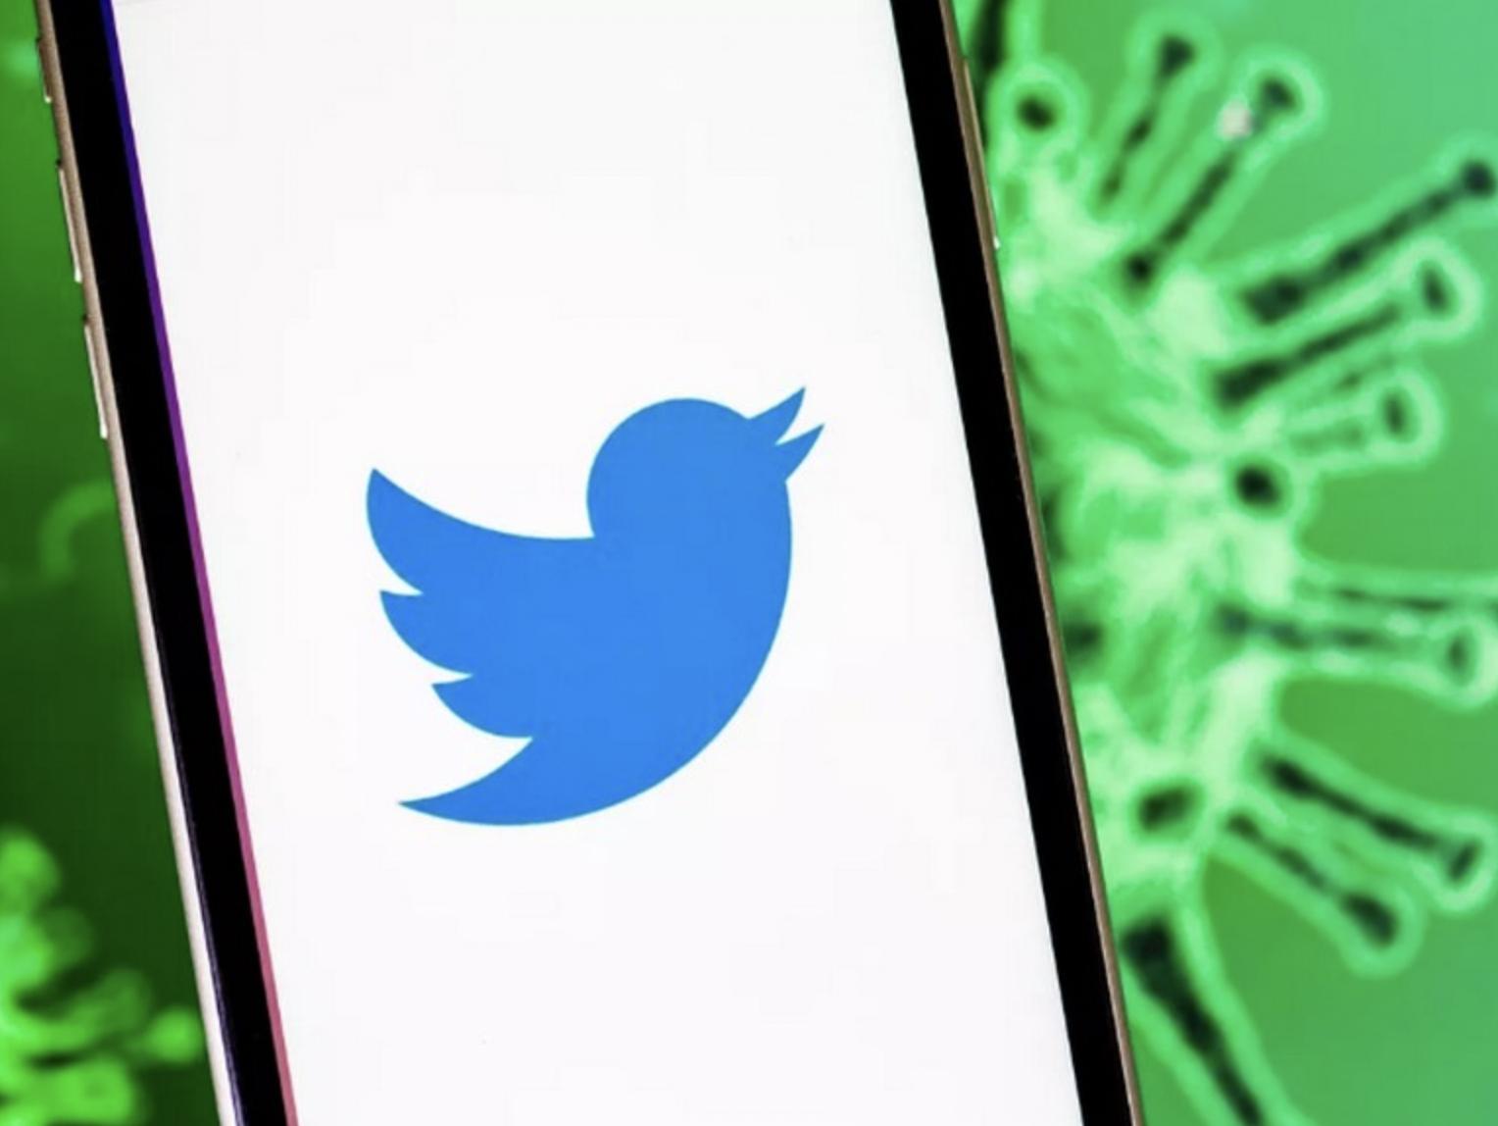
Discourse Analysis of COVID-19 Humorous Tweets
Bageshree Ramdas Bageshwar
&
Shahila Zafar
Central University of Punjab, India

Slide 2
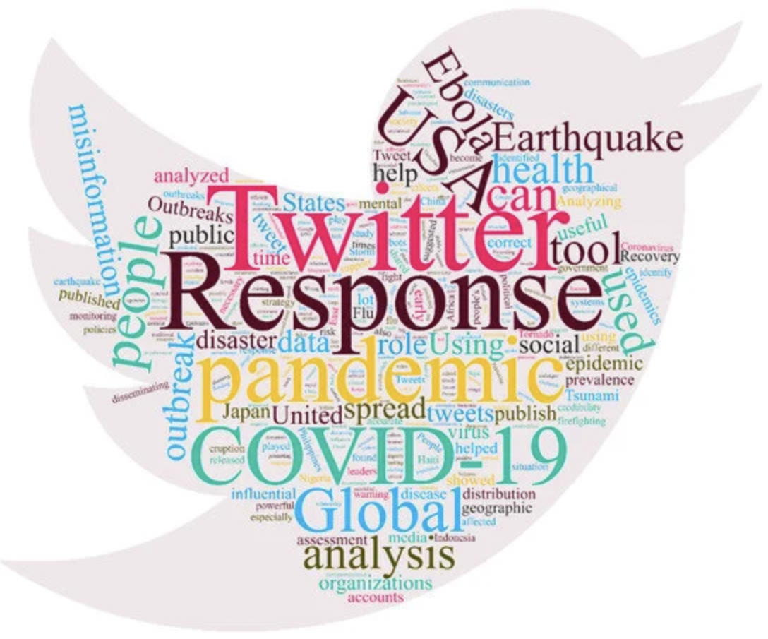
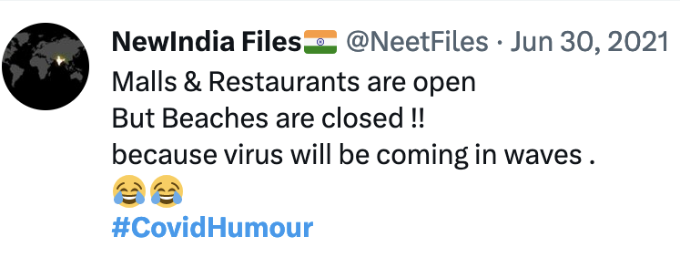
Introduction
COVID-19 pandemic
Major global health crisis in the age of social media
Millions of tweets by millions of Twitter users
Tweets about the COVID-19 tests and deaths, lockdown, quarantine, job cuts, online education, work from home, politics
Tweets, humorous in nature, a bit surprising in the serious pandemic situation

Slide 3
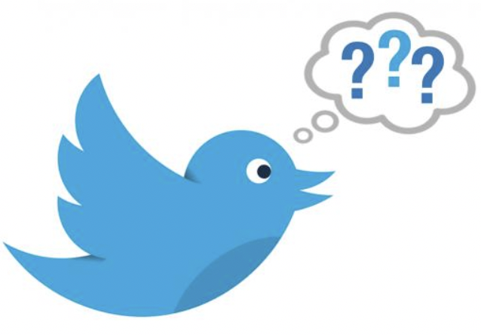
Research Questions
How do Twitter users respond to COVID-19 through humour?
How is this humorous discourse structured?
How are the six tools of discourse analysis, “social languages”, “situated meanings”, “figured worlds”, “intertextuality”, “Discourses”, and “Conversations” used to build the seven tasks, viz., “significance”, “practices”, “identities”, “social relationships”, “politics”, “connections”, and “sign systems and knowledge” in the selected tweets, in a given context?

Slide 4
Methodology
Discourse analysis of 54 tweets containing #covidhumour
Theory of Discourse Analysis – James Paul Gee (2011)
“Saying things in language never goes without also doing things and being things” (Gee, 2011, p. 2).
Construction or building of seven things or seven areas of “reality” (Gee, 2011, p. 17)
Seven building tasks and six tools of inquiry: Six questions to ask about seven things, a total of 42 questions

Slide 5
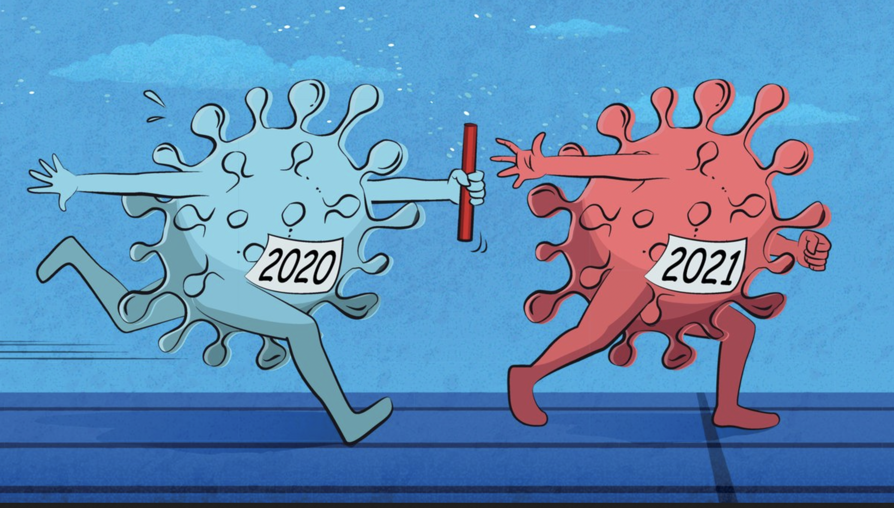
Data collection
“Advanced Search” feature of Twitter
Inclusion criteria:
Contain hashtag #covidhumour
Tweeted in the years 2020 and 2021
Be in English
Be intelligible
Be in text form (Image or video analysis is beyond the scope of this study)
Not be an advertisement

Slide 6
Data analysis
*“Seven Building Tasks” of language:
Significance
Practices (Activities)
Identities
Relationships
Politics
Connections
Sign Systems and Knowledge
*“Tools of Inquiry” - to analyse the workings of the seven building tasks, in specific instances of language-in-use:
Social Languages
Situated Meanings
Figured Worlds
Discourses
Conversations
Intertextuality
*Proposed by James Paul Gee (2011)

Slide 7
Figure 1: Sample Tweet Analysis
@Cvaanee. May 7, 2021

Slide 8
Building 1. Significance 2. Practices
Everyday conversational, informal social language - ‘dad’, ‘dude’, ‘fuck off’, ‘app’, ‘toilet paper’, ‘pajamas’, ‘hey’, ‘guy’, ‘mum’, ‘kids’, - significance for the informal discussion of COVID-19 on Twitter
Practices specific to COVID-19 – vaccination, sanitisation, Rapid Antigen Test, drinking Geloy juice to boost immunity, working from home, using Zoom for virtual meetings
Intertextuality: “Go Corona Go” – a practice of reproducing the slogan in the context of a locust attack as “Go Locust Go”

Slide 9
Building 3. Identities 4. Social Relationships
Social language of anxiety: ‘Ugh so stressed’, ‘I really need this new doctor’, ‘OMG!’ – identity of the author as a stressed-out person
Literary social language: Personification - Coronavirus is anthropomorphised and depicted as a survivor because of its mutating nature
Everyday informal social language: pronouns like ‘you’ and ‘we’ in the tweets - a close social relationship with the readers

Slide 10
Building 5. Politics 6. Connections
Creation of social goods: vaccine, mask, Rapid Antigen Test, Covid App, sanitiser, positive mindset, doctor (medical attention), Geloy juice, social awareness
Discourses and Conversations are used to connect:
lockdown and the homemade haircuts of people
over sanitisation and the roadside breath test
vaccine passport and Gmail password
2020 toilet paper shortage and the curiosity of future kids
work from home and pajamas

Slide 11
Building 7. Sign Systems and Knowledge
Situated meanings, Discourses, Conversations - privileging the sign system and knowledge of preventive behaviour during COVID-19, like wearing a mask, vaccination, social distancing, sanitisation, and virtual meetings via Zoom
Intertextuality: ‘InshaAllah’, meaning ‘God willing’ - privileging the ways of knowing the ways of God
De-privileging harmful sign systems during the pandemic such as gathering more people, partying, taking off masks

Slide 12
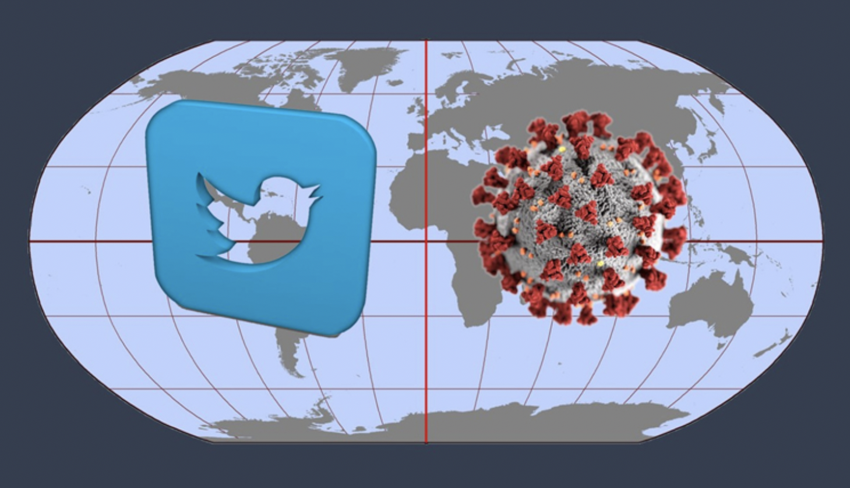
Conclusion
Six tools – building seven tasks in the tweets
Social languages – most prominently used tool
Intertextual elements from various fields like religion, science fiction, politics, mythology
Authors and readers as individuals coping with the serious COVID-19 crisis with the help of humour
A social relationship between an aware individual and the audience experiencing the same feelings
Creation of a social good ‘healthcare’
Connecting irrelevant things using tools to create humour
Connecting life before and after COVID-19
Privileging the sign system of adapting to a difficult situation with the help of humour

Slide 13
References
Abel, M. (2002). Humor, stress, and coping strategies. Humor: Int. J. Humor Res. 15(4), 365–381. https://home.csulb.edu/~djorgens/abel.pdf
Chitragupta. (2022). Retrieved November 11, 2022, from https://en.wikipedia.org/wiki/Chitragupta
COVID-19. (2022). Retrieved January 3, 2022, from https://en.wikipedia.org/wiki/COVID-19
Coady, A., Lainchbury, K., Godard, R., & Holtzman, S. (2022). What twitter can tell us about user experiences of crisis text lines: A qualitative study. Internet Interventions, 28. https://doi.org/10.1016/j.invent.2022.100526
Gee, J. (1999). An Introduction to Discourse Analysis: Theory and method (1st ed.). Routledge.
Gee, J. (2011). An Introduction to Discourse Analysis: Theory and method (3rd ed.). Routledge.
Glaˇ veanu, V. P., & de Saint Laurent, C. (2021). Social Media Responses to the Pandemic: What Makes a Coronavirus Meme Creative. Frontiers in Psychology, 12. http://dx.doi.org/10.3389/fpsyg.2021.569987

Slide 14
References
Halliday, M. A. K. (1978). Language as social semiotic: The social interpretation of language and meaning. London: Edward Arnold.
Hussein, A., & Aljamili, L. (2020). COVID-19 humor in Jordanian social media: A socio-semiotic approach. Heliyon, 6(12). https://doi.org/10.1016/j.heliyon.2020.e05696
Inshallah. (2022). Retrieved November 12, 2022, from https://en.wikipedia.org/wiki/Inshallah
Jha, V. K., Hrudya, P., Vinu, P. N., Vijayan, V., & Prabaharan, P. (2020). DHOT-Repository and Classification of Offensive Tweets in the Hindi Language Procedia Computer Science, 171, 2324–2333. http://dx.doi.org/10.1016/j.procs.2020.04.252
Martin, R. A.﻿ (2007). The Psychology of Humor: An Integrative Approach. Academic Press.
Martínez-Cardama, S., & García-López, F. (2021). Ephemeral mimetics: memes, an X-ray of Covid-19. The European Journal of Humour Research, 9(4), 35–57. http://dx.doi.org/10.7592/EJHR2021.9.4.558

Slide 15
References
Nezlek, J. B., & Peter, D. (2001). Use of humor as a coping mechanism, psychological adjustment, and social interaction. Humor – International Journal of Humor Research, 14(4), 395-413. doi: https://doi.org/10.1515/humr.2001.011
Pabel, A., & Turnšek, M. (2022). Travel-related humour and COVID-19: insights from memes. The European Journal of Humour Research, 10(3), 211–216. http://dx.doi.org/10.7592/EJHR2022.10.3.659
Tsakona, V. (2020). Recontextualizing Humor: Rethinking the Analysis and Teaching of Humor. De Gruyter Mouton.
Ukwueze, O., & Igbokwe, C. (2021). Playful Subjects of Lack: The Underside of Humour in the Nigerian Unconscious. English Academy Review, 38(2), 8-20. https://doi.org/10.1080/10131752.2021.1987648
Venugopal, V. (2020, May 29). 'Locusts Cannot Afford Mumbai': Twitter Turns to Jokes as Swarms of Fake Videos Go Viral. News 18. https://www.news18.com/news/buzz/locusts-cannot-afford-mumbai-twitter-turns-to-jokes-as-swarms-of-fake-videos-go-viral-2642595.html

Slide 16
References
Wicke, P. & Bolognesi, M. (2021). Covid-19 Discourse on Twitter: How the Topics, Sentiments, Subjectivity, and Figurative Frames Changed Over Time. Frontiers in Communication, 6. doi: 10.3389/fcomm.2021.651997
Yang, X. (2001). [Review of the book An Introduction to Discourse Analysis: Theory and Method, by J. P. Gee]. Language in Society, 30(4), 646-649.

Slide 17
Thank you

