Slide 1
Is Humor a Socially Conditioned Reflex: A Survey Analysis
Anupama T
Ph.D. Linguistics and Phonetics
The English and Foreign Languages University (EFLU), Hyderabad, India.
anupamaphdlandp21@efluniversity.ac.in

Slide 2
INTRODUCTION
A sociolinguistic survey.
Conducted to understand: the evolution of language and "bad joke.”
Consider the social hierarchy existing in Indian society.
Evaluate whether "our humor is only a socially conditioned reflex or not“.

Slide 3
RESEARCH QUESTIONS
Does social hierarchy play a role in whether a joke is acceptable or unacceptable in society?
Can language tools be used to manipulate jokes into good or bad?
Are people in Indian society expressing their unacceptability towards socially and morally questionable jokes?
Have language revolving around the context of joke evolved in India?

Slide 4
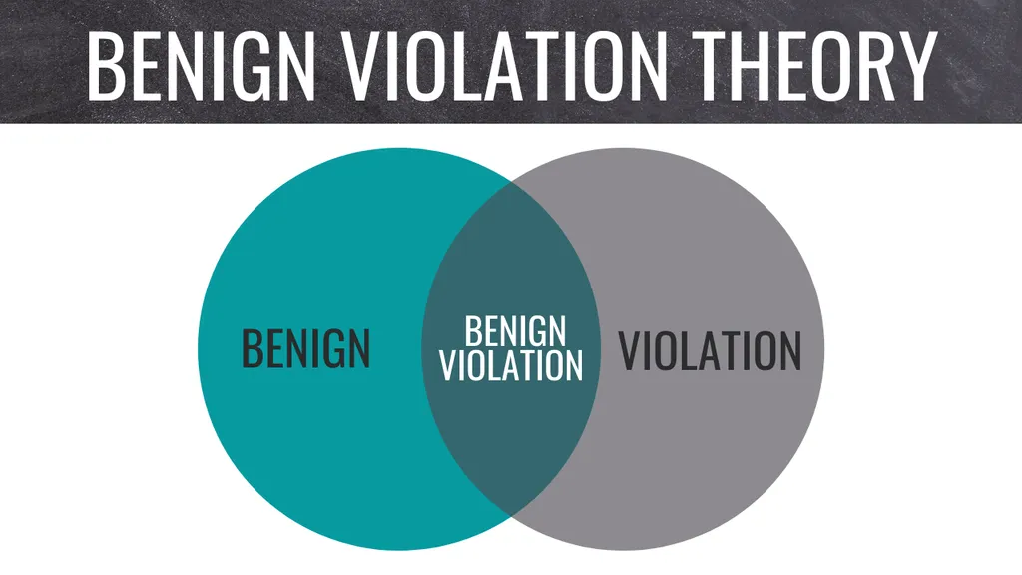
LITERARY THEORY
Benign Violation Theory (BVT)
proposed by Caleb Warren and Peter McGraw in 2010.

Slide 5
Data collection methods
Online survey questions spread through various media platforms.
Age category: 18-29, 30-49, 50+.
Gender category: Female, Male, Transgender.

Slide 6
Data elicitation and findings
Total responses received: 76
18-29: Maximum responses, 64.
30-49: 9 responses.
50+: Least responses, 3.
Female participants maximum, 57.
No responses from transgender.

Slide 7
Data elicitation and findings
31 questions; age, gender, suggestions/ comments/ extra input, etc.,
Random Sampling method
Randomly selected 4 participants from each age category.
2 females and 2 males each.

Slide 8
Data elicitation and findings

Slide 9
Data elicitation and findings

Slide 10
Data elicitation and findings

Slide 11
Data elicitation and findings

Slide 12
Data elicitation and findings

Slide 13
Data elicitation and findings

Slide 14
Data elicitation and findings

Slide 15
Data elicitation and findings

Slide 16
Data elicitation and findings

Slide 17
Data elicitation and findings

Slide 18
Data elicitation and findings

Slide 19
Data elicitation and findings

Slide 20
Data elicitation and findings

Slide 21
Data elicitation and findings

Slide 22
Data elicitation and findings

Slide 23
Data elicitation and findings

Slide 24
Data elicitation and findings

Slide 25
limitations
Lesser responses from the age categories: 30-49, 50+
No responses from transgender.
Lesser responses from males as compared to females.
Survey lacked examples of jokes to the question and let the participants evaluation from their day-to-day experience.

Slide 26
conclusion
People engage in jokes depending on the social hierarchy.
People pretend to enjoy jokes of speakers from a higher hierarchy.
Language tools used to manipulate jokes.
Language is an important component in expressing humor.
People started expressing non-acceptance to bad jokes.

Slide 27
references
Aktas, M., Gelfand, M. J., and Hanges, P. J. (2015). Cultural tightness–looseness and perceptions of effective leadership. J. Cross-Cult. Psychol. 47, 294–309. DOI: 10.1177/0022022115606802
Chhokar, J. S., Brodbeck, F. C., and House, R. J. (eds.) (2007). Culture and leadership across the world: The GLOBE book of in-depth studies of 25 societies. (Mahwah NJ: Lawrence Erlbaum).
Eatough, E. M., Chang, C.-H., Miloslavic, S. A., and Johnson, R. E. (2011). Relationships of role stressors with organizational citizenship behavior: a meta-analysis. J. Appl. Psychol. 96, 619–632. DOI: 10.1037/a0021887
Festinger, L. (1962). Cognitive dissonance. Sci. Am. 207, 93–107. DOI: 10.1038/scientificamerican1062-93
Gandhi, M. (1940). An autobiography, or the story of my experiments with truth. 2nd edn. (Ahmedabad: Navajivan).
Geddes, D., and Callister, R. R. (2007). Crossing the line(s): a dual threshold model of anger in organizations. Acad. Manag. Rev. 32, 721–746. DOI: 10.2307/20159331
Gelfand, M. J., Raver, J. L., Nishii, L., Leslie, L. M., Lun, J., Lim, B. C., et al. (2011). Differences between tight and loose cultures: a 33-nation study. Science 332, 1100–1104. DOI: 10.1126/science.1197754
Gottman, J. M., Katz, L. F., and Hooven, C. (1996). Parental meta-emotion philosophy and the emotional life of families: theoretical models and preliminary data. J. Fam. Psychol. 10, 243–268. DOI: 10.1037/0893-3200.10.3.243
Gray, J. A., and Ford, T. E. (2013). The role of social context in the interpretation of sexist humor. Humor 26, 277–293. DOI: 10.1515/humor-2013-0017
Hemmasi, M., Graf, L. A., and Russ, G. S. (1994). Gender-related jokes in the workplace: sexual humor or sexual harassment? 1. J. Appl. Soc. Psychol. 24, 1114–1128. DOI: 10.1111/j.1559-1816.1994.tb02376.x

Slide 28
references
Jiang, T., Li, H., and Hou, Y. (2019). Cultural differences in humor perception, usage, and implications. Front. Psychol. 10, 123–123. DOI: 10.3389/fpsyg.2019.00123
Kant, L., & Norman, E. (2019). You Must Be Joking! Benign Violations, Power Asymmetry, and Humor in a Broader Social Context. Frontiers in Psychology, 10. https://doi.org/10.3389/fpsyg.2019.01380
Kim, H. S., and Plester, B. A. (2019). Harmony and distress: humor, culture, and psychological well-being in south Korean organizations. Front. Psychol. 9:2643. doi: 10.3389/fpsyg.2018.02643
Knegtmans, H., van Dijk Wilco, W., Mooijman, M., van Lier, N., Rintjema, S., and Wassink, A. (2018). The impact of social power on the evaluation of offensive jokes. Humor 31:85. DOI: 10.1515/humor-2017-0106
Lewis, C. S. (1949). The weight of glory, and other addresses. (New York: Macmillan Co).
Liberman, N., Trope, Y., and Stephan, E. (2007). “Psychological distance” in Social psychology: Handbook of basic principles. vol. 2. eds. A. W. Kruglanski, and E. T. Higgins (New York, NY: Guilford Press), 353–383.
Luthar, V. K., and Luthar, H. K. (2002). Using Hofstede's cultural dimensions to explain sexually harassing behaviours in an international context. Int. J. Hum. Resour. Manag. 13, 268–284. DOI: 10.1080/09585190110102378
Magee, J. C., and Smith, P. K. (2013). The social distance theory of power. Personal. Soc. Psychol. Rev. 17, 158–186. DOI: 10.1177/1088868312472732
Martin, R. A., and Ford, T. (2018). The psychology of humor: An integrative approach. (Academic press).
McGraw, A. P., and Warren, C. (2010). Benign violations: making immoral behavior funny. Psychol. Sci. 21, 1141–1149. DOI: 10.1177/0956797610376073

Slide 29
references
McGraw, A. P., Williams, L. E., and Warren, C. (2014). The rise and fall of humor: psychological distance modulates humorous responses to tragedy. Soc. Psychol. Personal. Sci. 5, 566–572. DOI: 10.1177/1948550613515006
Meyer, J. C. (2000). Humor as a double-edged sword: four functions of humor in communication. Commun. Theory 10, 310–331. DOI: 10.1111/j.1468-2885. 2000.tb00194.x
Olin, L. (2016). Questions for a theory of humor. Philos Compass 11, 338–350. doi: 10.1111/phc3.12320
Piff, P. K., Stancato, D. M., Côté, S., Mendoza-Denton, R., and Keltner, D. (2012). Higher social class predicts increased unethical behavior. Proc. Natl. Acad. Sci. USA 109, 4086–4091. doi: 10.1073/pnas.1118373109
Plester, B. (2016). The complexity of workplace humor. (London: Springer).
Stephan, E., Liberman, N., and Trope, Y. (2011). The effects of time perspective and level of construal on social distance. J. Exp. Soc. Psychol. 47, 397–402. DOI: 10.1016/j.jesp.2010.11.001
Warren, C., Barsky, A., and McGraw, A. P. (2018). Humor, comedy, and consumer behavior. J. Consum. Res. 45, 529–552. DOI: 10.1093/jcr/ucy015
Warren, C., and McGraw, A. P. (2016). Differentiating what is humorous from what is not. J. Pers. Soc. Psychol. 110, 407–430. doi: 10.1037/pspi0000041
Weiner, B. (2006). Social motivation, justice, and the moral emotions: An attributional approach. (Mahwah, NJ: Lawrence Erlbaum Associates).

Slide 30
THANK YOU

