Slide 1
Receiving! It shouldn’t be intimidating…..

Slide 2
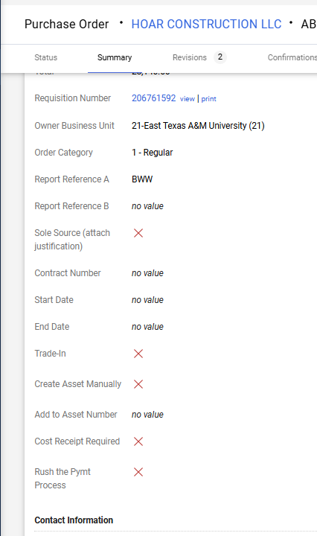
Two types of Receiving:
Quantity = this is the default receiving. This type of receiving is by
the number…if you have a line of quantity 5, and you ‘received’ 2,
then your receiving would be 2.
Cost Receipt Required = use this flag only if you are wanting
to do the receiving on the PO as a cost receipt, meaning that
you will receive by dollar amount versus quantity amount.
IF you use this flag, your quantities per line item
can not be larger than 1.

Slide 3
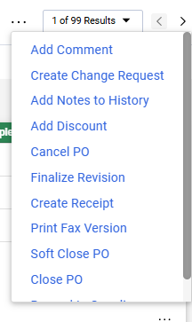
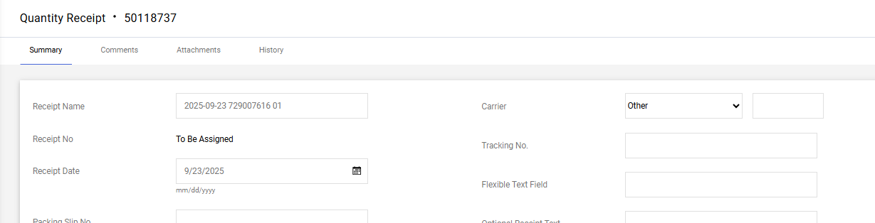
Receiving. Go to the three dots in the top right corner of the PO.
Receiving should be done when the products or services have been received.
Please do not do receiving on the PO as soon as you get the email notice that your requisition has been approved and is now a PO.
IF you have a subscription or a contract that has an end date of a future date, do the receiving as the end date. Example, if your first year ends on 8/31/2026, then do the receiving as of 8/31/2026.

Slide 4
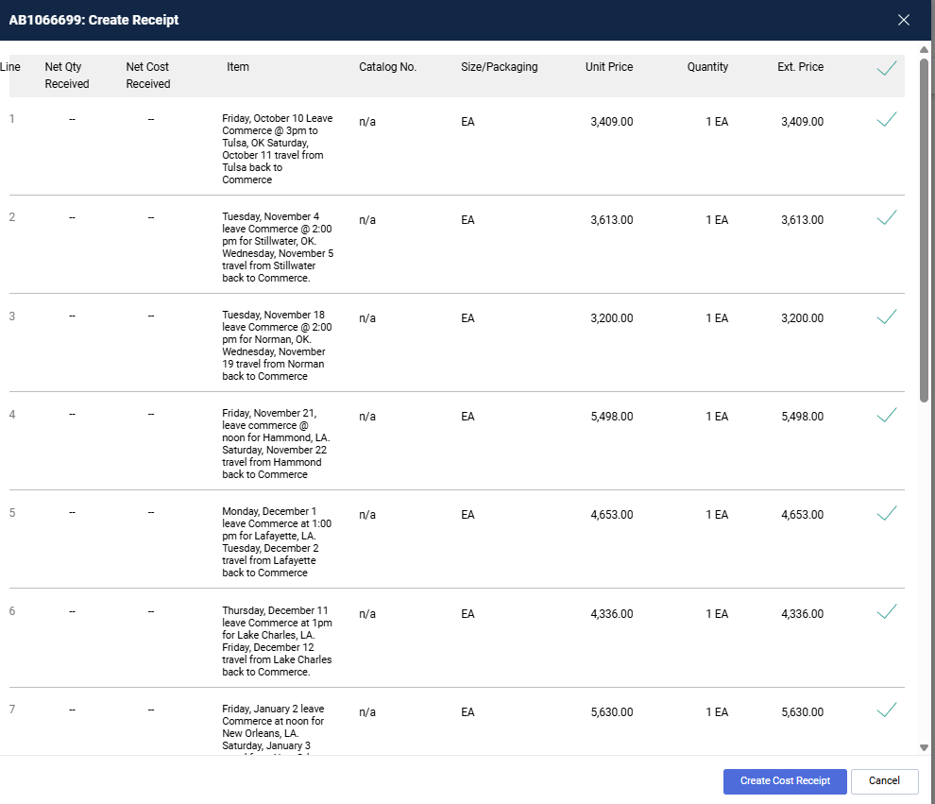
Receiving should be done only on the line(s) you have the product or
services. Multi-line PO’s should be carefully received, as you may not
want to ‘receive’ each line.
Only select the line(s) you want to
receive. If all of them, leave these
all checked. If only a select few, then
uncheck everything, and select the
particular lines you are going to do this
receiving on.

Slide 5
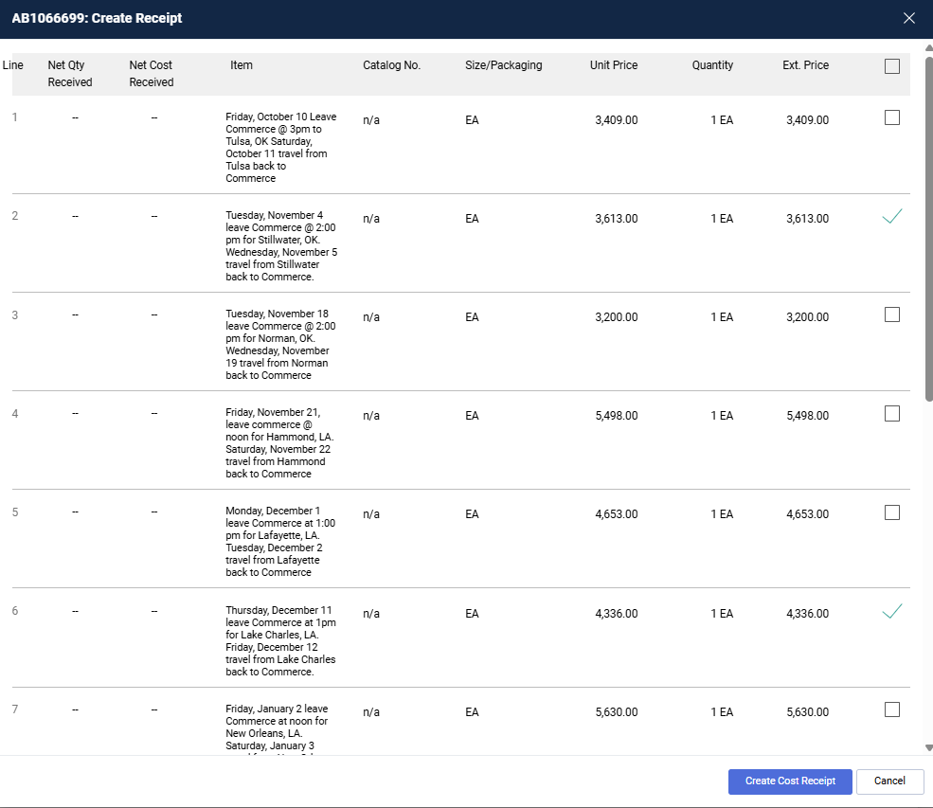
On this example, I unchecked all line
items and only checked lines 2 and 6.
Now click Create Cost Receipt Or Create Quantity Receipt depending on the type of receiving you are doing…

Slide 6
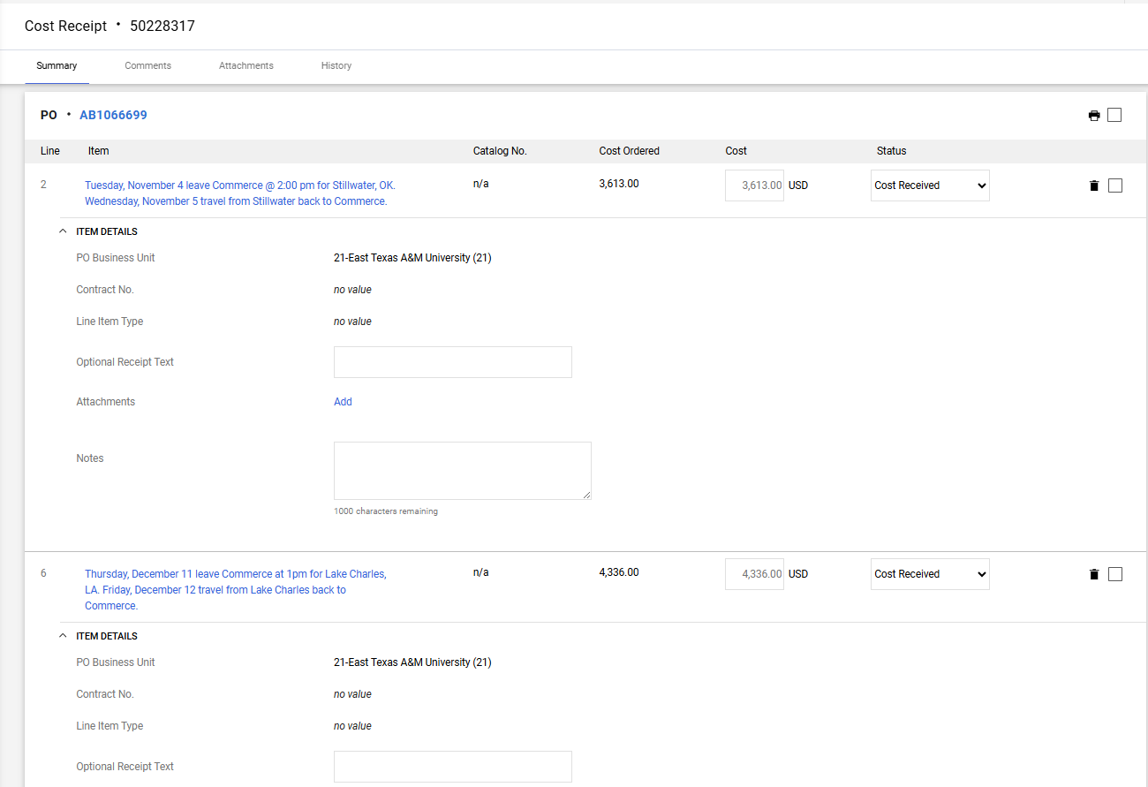
Here you will now see
lines 2 and 6 displayed
From here you can
‘receive’ the amount in
the box or update that
amount to the dollar you
wish to receive

Slide 7
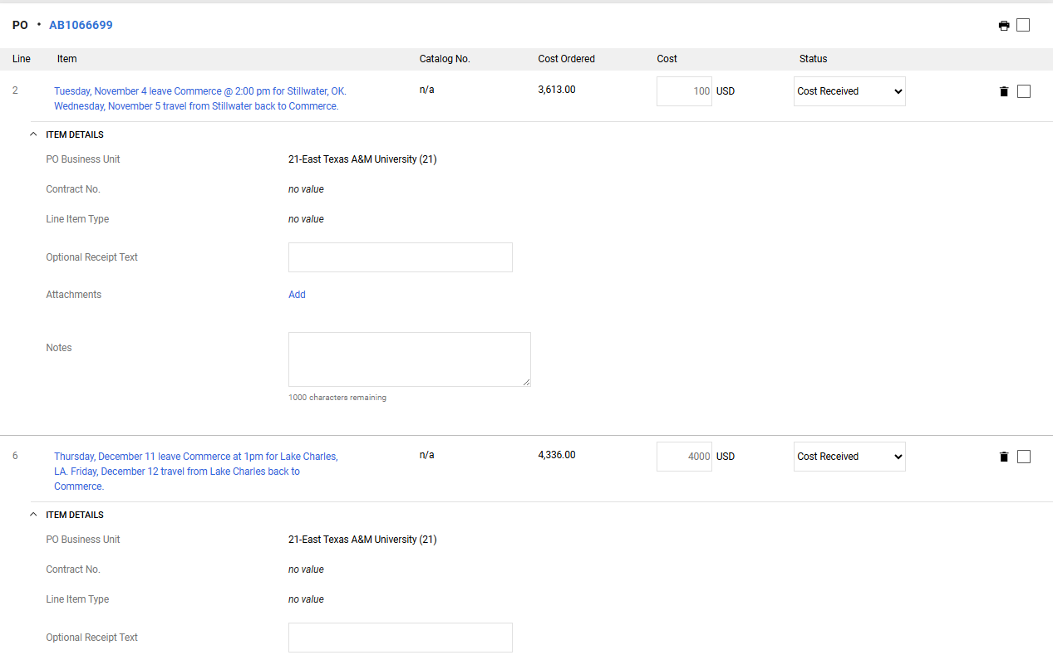
I only want to
receive $100 on
Line 2 and only
$4000 on Line 6

Slide 8
Click on the Complete button on the top right when you are done

Slide 9
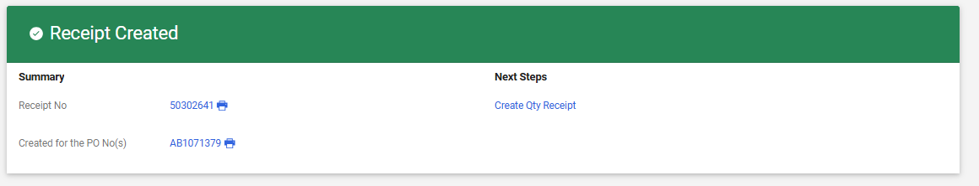
Once you have clicked COMPLETE, your next screen will look like this:

Slide 10
From here, click on the PO Number

Slide 11
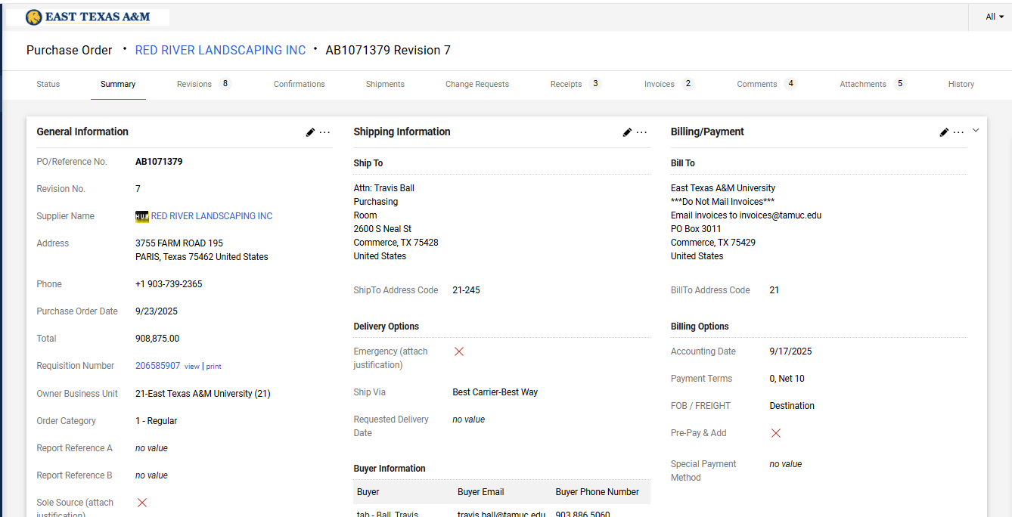
Now you should be back at your PO. From here, click on the Comments tab

Slide 12
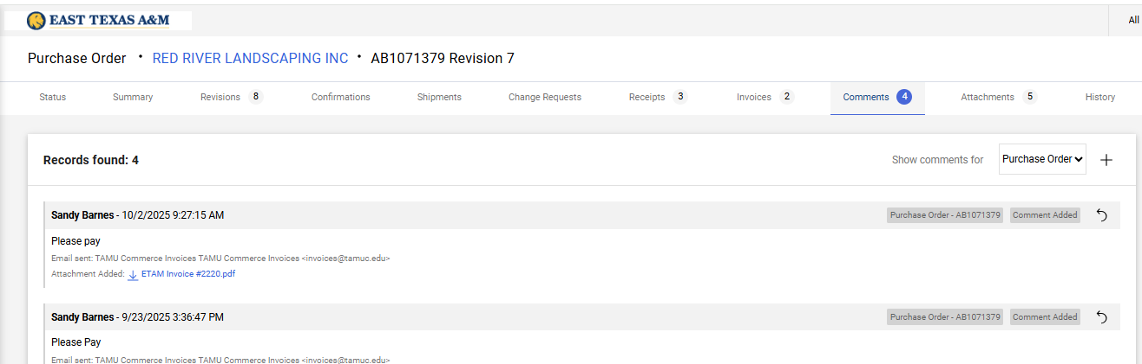
Here is where it gets a bit tricky. IF YOU HAVE THE INVOICE, you need to leave a new comment, (click on the +)

Slide 13
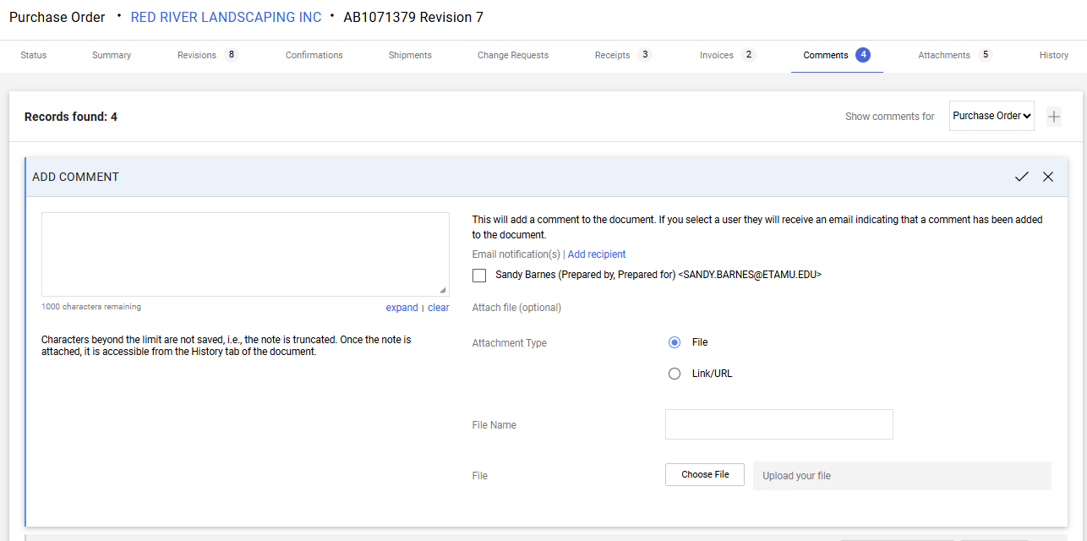
So type PLEASE PAY in the comment box, then click on the blue Add Recipient

Slide 14
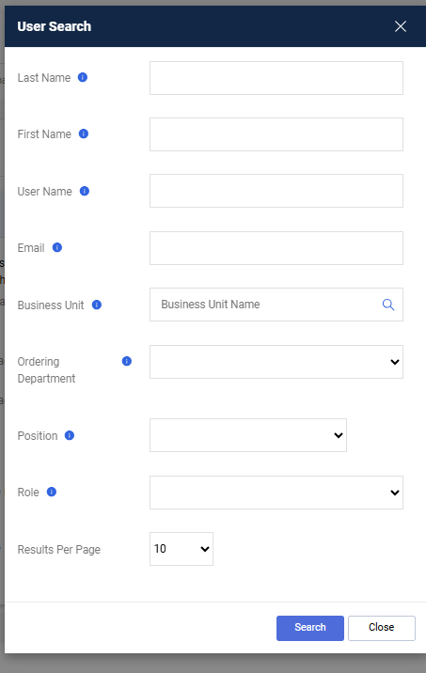
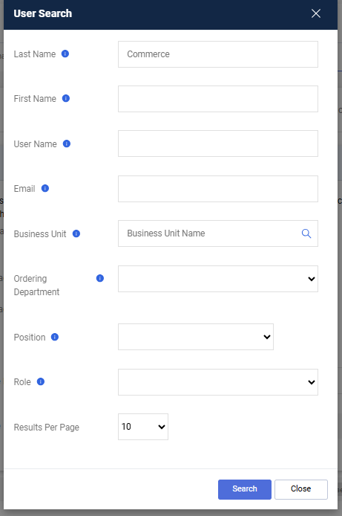
So PLEASE PAY in the comment box, then click on the blue Add Recipient

Slide 15
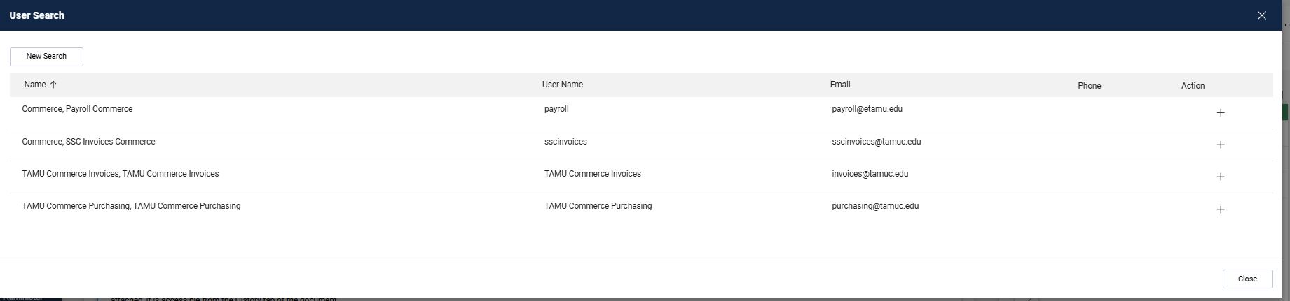
Click the + to choose Commerce Invoices

Slide 16

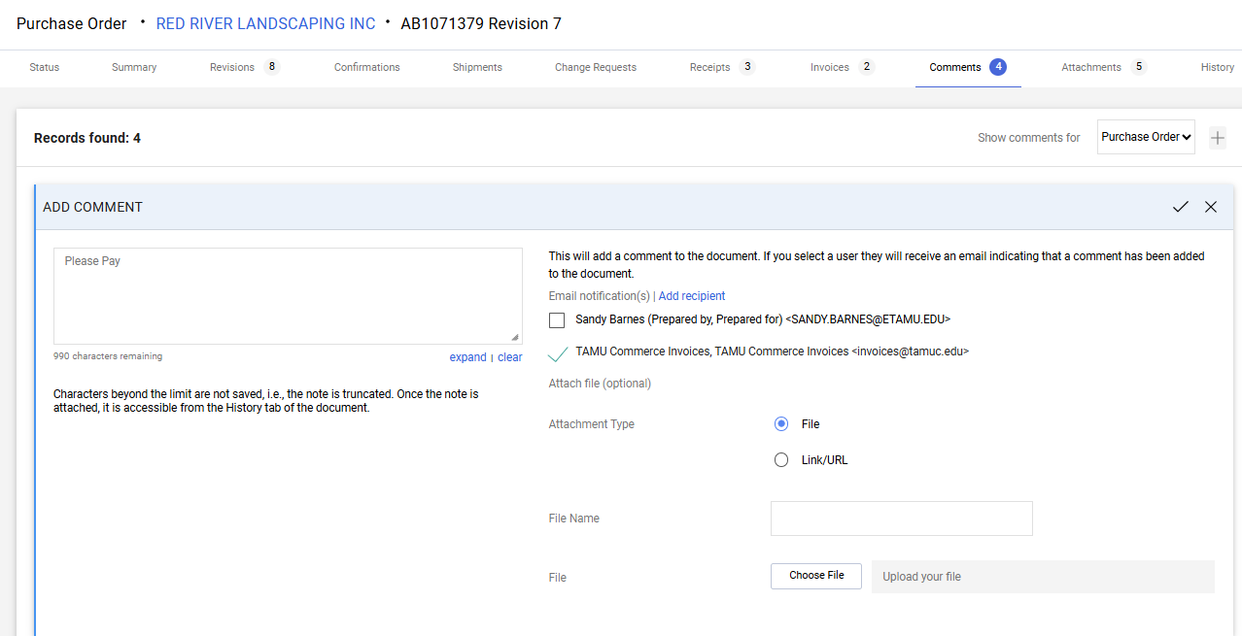
Now you need to Choose File and attach your invoice. Then click the
Congratulations! You are done!

Slide 17
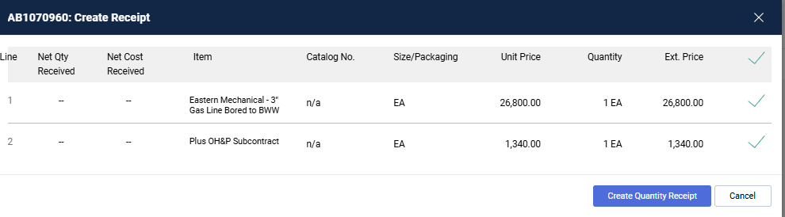
EXAMPLES OF RECEIVING
This is a Quantity Receipt PO

Slide 18
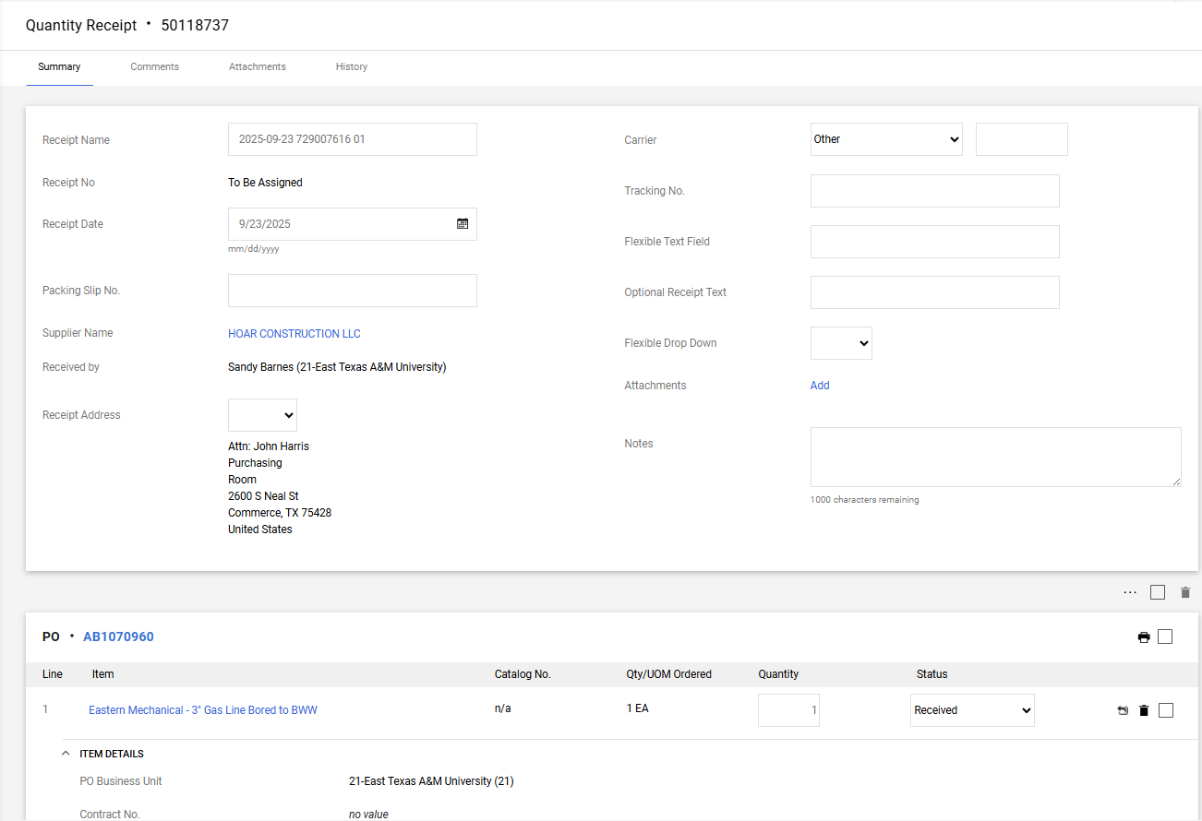

Slide 19
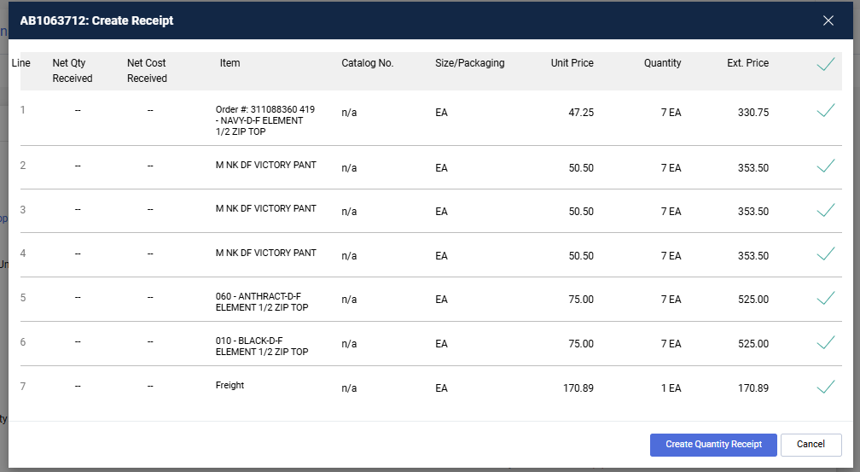
Another Quantity Receipt PO
Uncheck the lines you don’t want to receive, or leave all
Checked if you are wanting to receive all of them

Slide 20
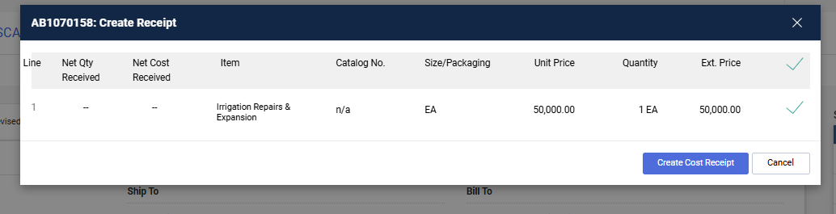
EXAMPLES OF RECEIVING
This is a Cost Receipt PO

Slide 21
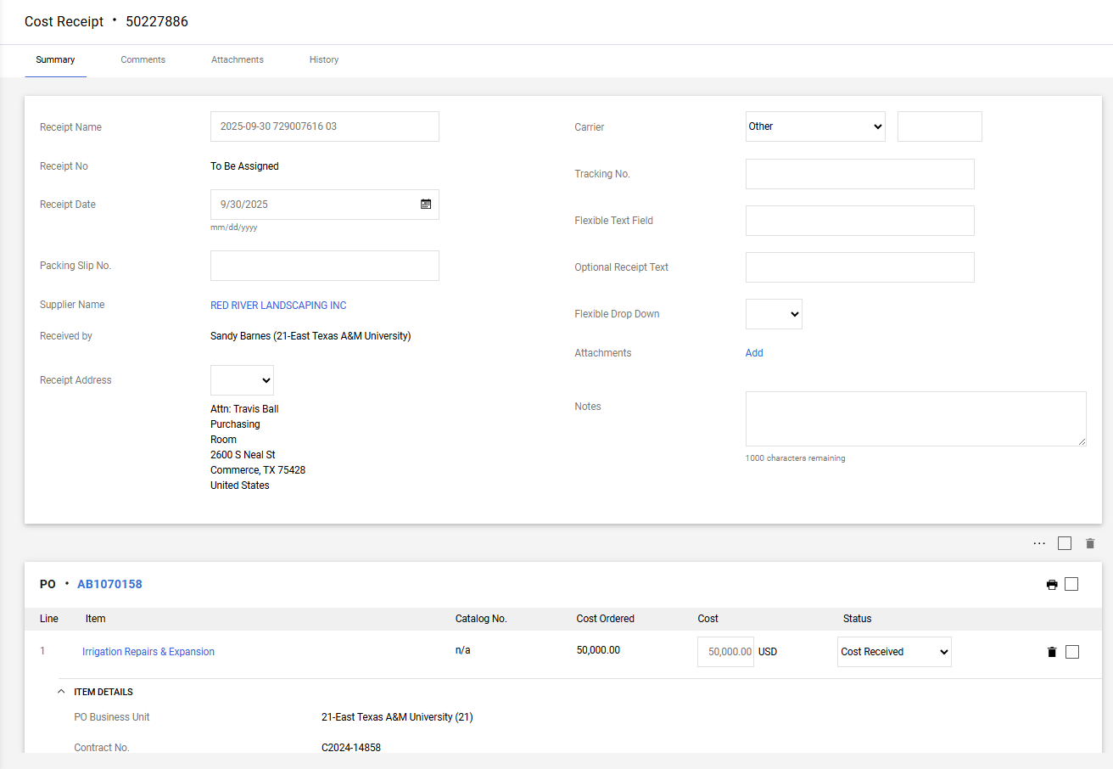

Slide 22
Commonly Used Vendors and Contract Numbers
VENDOR | COOPERATIVE CONTRACT #
Latson’s | TIPS 180401
B&A Concrete | TIPS 1802056
Berger | CNR01504
Intelligent | Buy Board 584-19
Apple | DIR TSO-3789
CESCO | DIR CPO-4438
Computer Solutions | DIR-TSO-4160
CMC Network | TIPS Contract 20300
Summus Dell | DIR-TSO-3763
Transact | C2021-3340
Texas Closed Captioning | C2022-6992
Airgas | C2022-5930
Athletic Supply | C2020-1642
One Source Commercial Flooring | Buy Board 642-21
Medco Supply Company | Buy Board 610-20
Intelligent Interiors | Buy Board 584-19
Avsant | TIPS 200904
Elliott Electric Supply | Buy Board 657-21
FACILITY INTERIORS INC | OMNIA CONTRACT # R191803
Total Fire & Safety | Buy Board 751-24

